Slide 1


Slide 2
Introduction
The term Economics has been derived from two words “IKONOMIKOS” which means “Laws of Households”.
We have two types of activities –
* Economic Activities
* Non-economic Activities

Slide 3
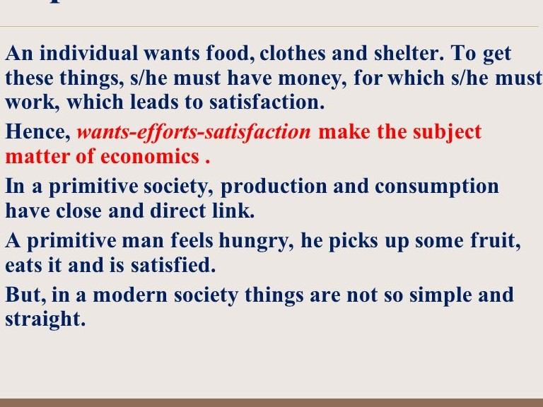

Slide 4
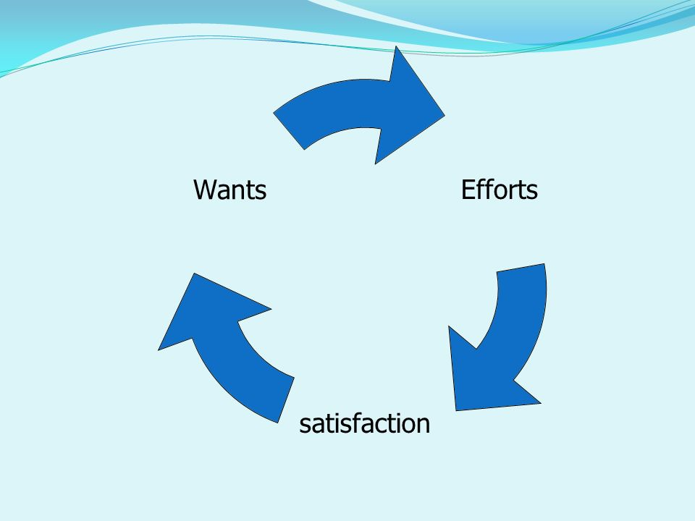

Slide 5
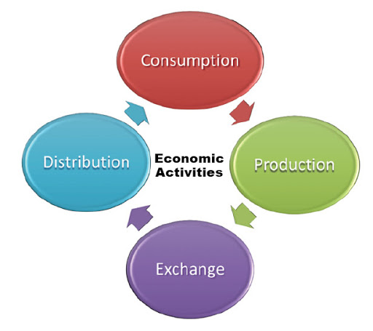
Economic Activities

Slide 6
Production Decisions: What to product, how to produce and how much to produce and for whom to produce.
Exchange Decisions: For what price it should be exchanged and for whom to sell.
Consumption Decisions: What to consume and how much?
Distribution Decisions: Among the four factors of production.

Slide 7
Definitions of Economics:
There are four types of Definitions:
Wealth Definition
Welfare Definition
Scarcity Definition
Growth Definition
Modern Definition

Slide 8
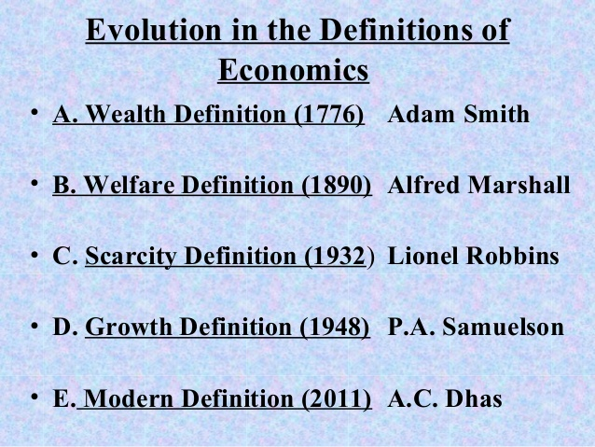

Slide 9
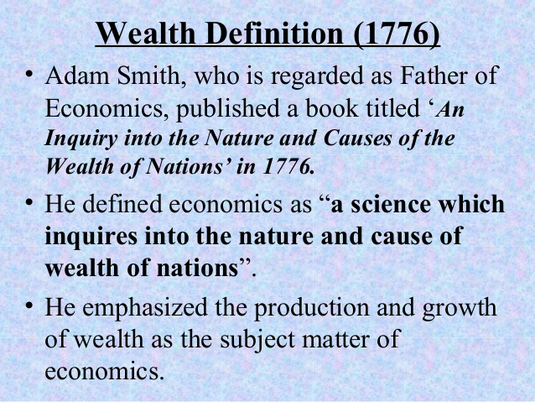

Slide 10
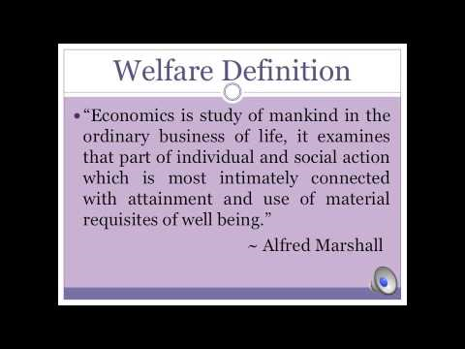

Slide 11
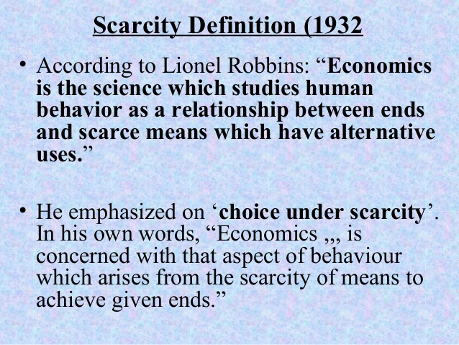

Slide 12
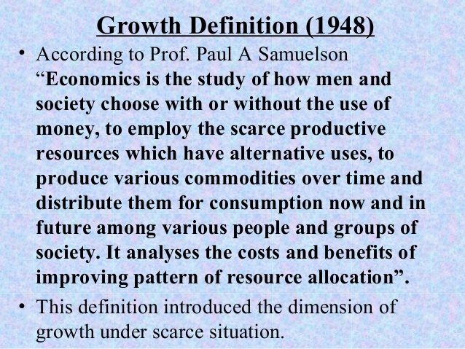

Slide 13
